Slide 1
Cryptography and Network Security
G.Pallavi
192311208

Slide 2
SECURITY ATTACKS
  Two generic types of attacks:
A Passive Attack attempts to learn or make use of information from the system but does not affect system resources.
An Active Attack attempts to alter system resources or affect their operation

Slide 3
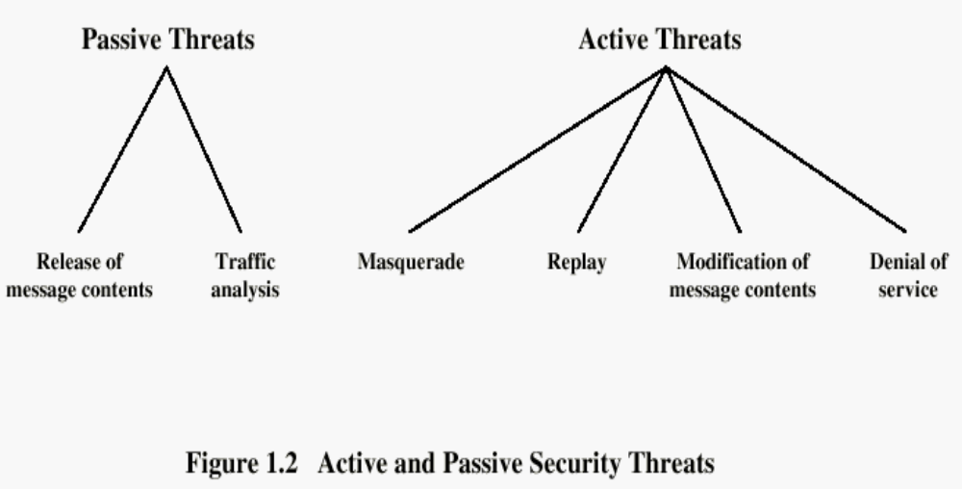
Eaves dropping

Slide 4
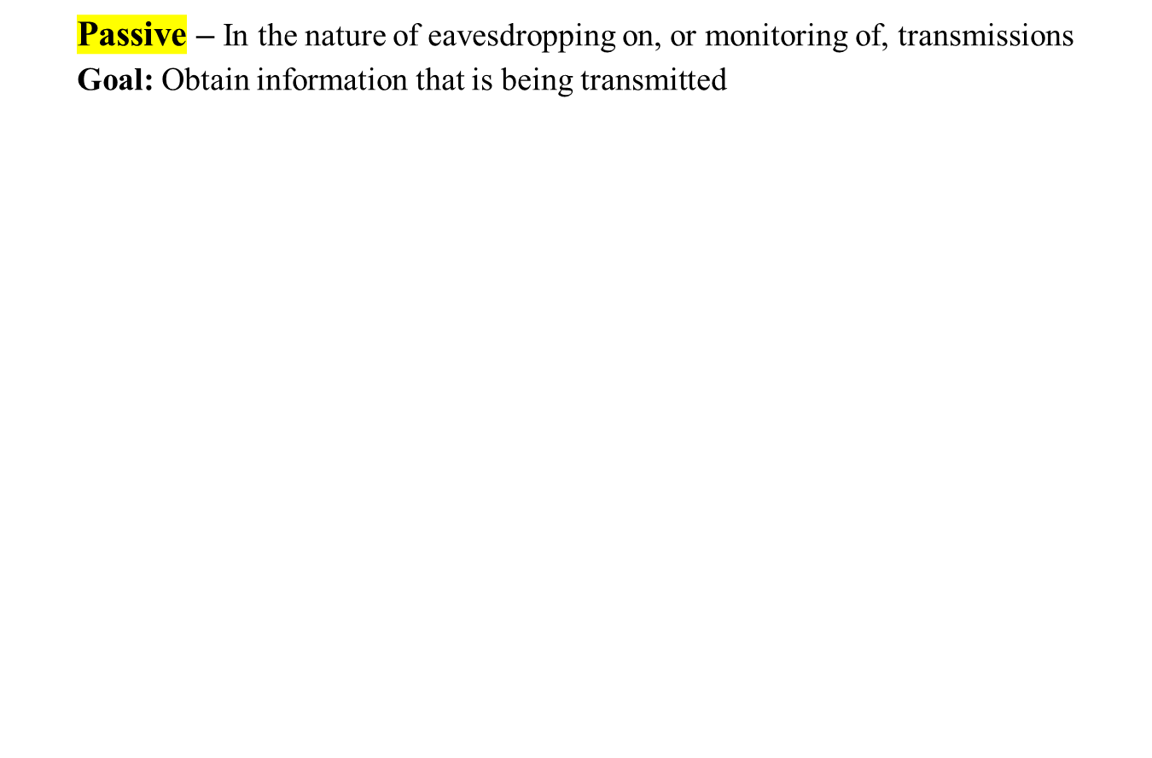

SECURITY ATTACKS
Notes:
Does not affect system resources.
Attempts to make use of info from system.

Slide 5
Two types of Passive Attacks:
EavesDropping -Read the content of the message
Traffic Analysis - Identifying the pattern of messages
Solution- Mask the content of the message- Encryption
Problem
If we had encryption Protection in place, an opponent might still be able to observe the pattern of these messages.
The opponent could determine the location and identity of communicating hosts and could observe the frequency and length of messages being exchanged.
This information might be useful in guessing the nature of the communication that was taking place.
Notes:
Reads contents of message from sender to receiver.

Slide 6
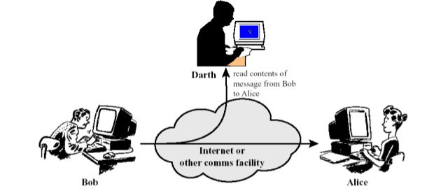
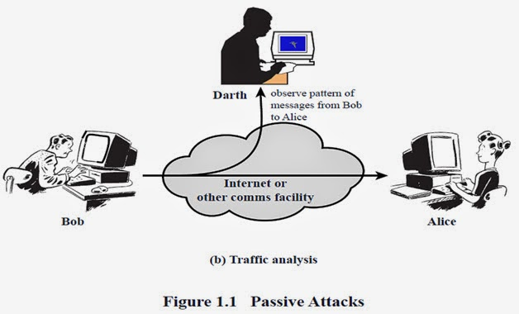
(a)Eaves dropping or Release of message content
Notes:
1.Listening to phone conversations.
2.Observe the pattern of sending msgs from sender to receiver.

Slide 7


SECURITY ATTACKS
Notes:
Involves some modification
it used to create false stream of info
4 types divided

Slide 8
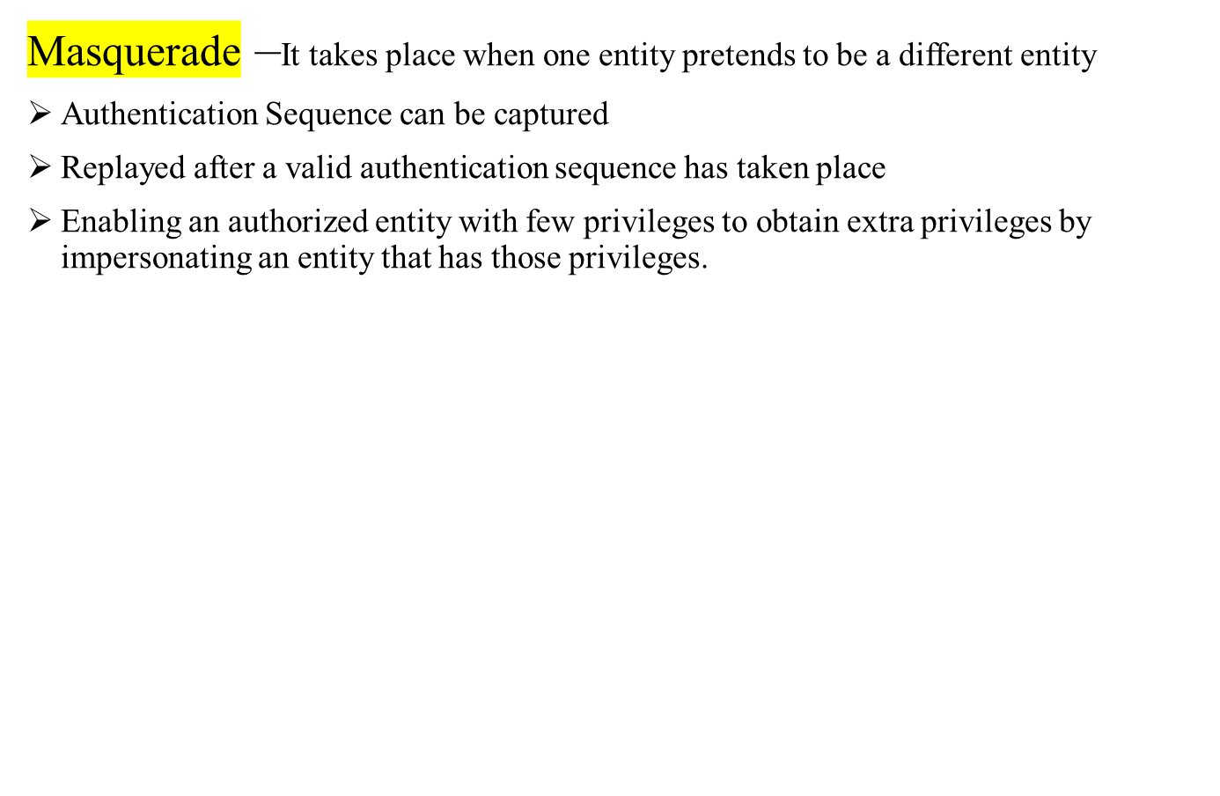
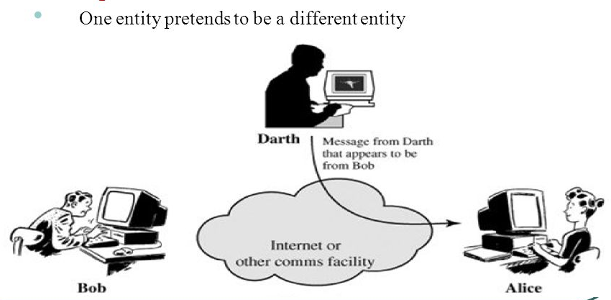
Notes:
Message from hacker but it appears to be as sender

Slide 9
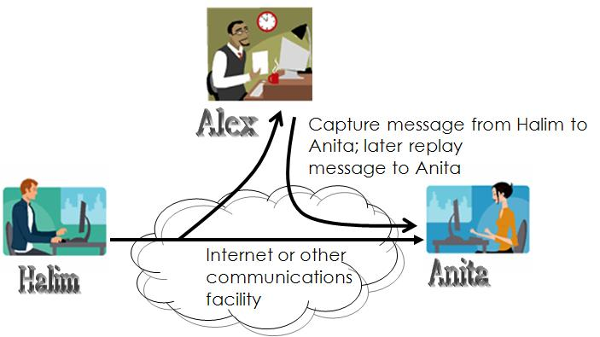
Replay- It involves the passive capture of a data unit and its subsequent retransmission to produce an unauthorized effect
Notes:
Captures messages and later sends same message to receiver.

Slide 10
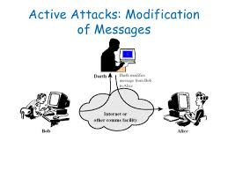
Modification of Message – Some portion of legitimate message is altered, or the messages are delayed or reordered to produce an unauthorized effect
Notes:
Hacker modifies messages

Slide 11
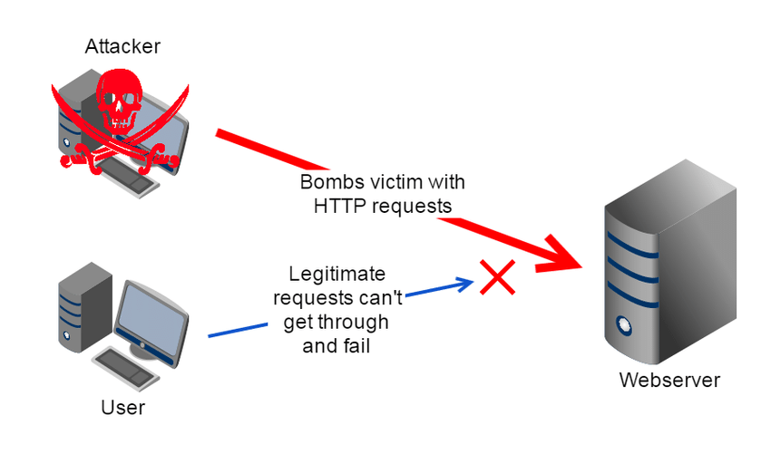
Denial Of Service - It prevents or inhibits the normal use or management of communications facilities
Notes:
Hacker disrupts the service provided by the receiver.
Making service unavailable to receiver.

Slide 12
Thank you

